Slide 1
Overview of ML
- ML is the field of study that gives computers the ability to learn without explicitly being programmed
- How is this done? Using learning algorithms (algorithms are a set of commands/rules)
- Main types of learning algorithms: Supervised Learning, Unsupervised Learning, Recommender System & Reinforcement Learning
- 99% of the economic value today is created by supervised learning (as of 2022)
Supervised Learning
- Supervised learning refers to algorithms that learn input → output mapping [X (input) → Y (output)]
- The algorithm is fed examples of correct mapping pairs
- After “seeing” sufficient correct mapping pairs, the algorithm eventually takes input X alone and predicts/guesses label Y
- The algorithm tries to fit the most appropriate function (boundary) to the data and then uses this function for prediction. This function can be a straight line or a curve or something even more complex.
Two main types of Supervised Learning Algorithms
Regression – The output label Y is a number (and thus can take infinitely many values)
Classification – The output label Y can take only a small number of possible values (finite/discrete) called categories/classes
Note: The input X can be numbers or categories (categories are encoded to numbers)
Note: In classification, the output label Y (classes) are encoded to numbers

Slide 2
Unsupervised Learning
- Unsupervised learning refers to algorithms that take only input data X (without output label Y) and try to automatically find structure/patterns in the data. Thus, there is no concept of providing X (input) → Y (label) mapping
Three major types of unsupervised learning algorithms:
Clustering – Grouping similar data points together
Anomaly Detection – Finding unusual data points
Dimensionality Reduction – Compress data representation using fewer numbers

Slide 3
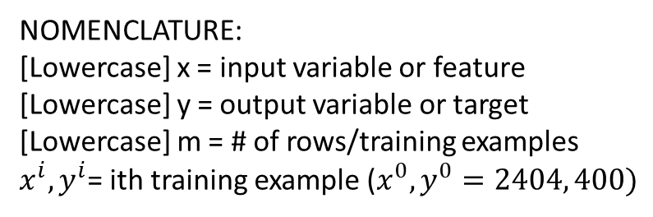
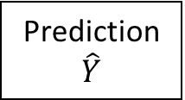
SUPERVISED LEARNING
Training Data or Training Set: Data used for training the model (correct X (input) →Y (output) mapping pairs)
TRAINING PROCESS
Training Set
- A training set is fed to the learning algorithm
- The learning algorithm will produce some function F
- Training a model means determining its parameters
- Once the model parameters are determined, a new input X is taken by F to output a prediction Y
Learning Algorithm
New Input X
Function/Model
F
Prediction $\hat{Y}$
Training Set - Example
x | y
2404 | 400
… | …
3210 | 870
NOMENCLATURE:
[Lowercase] x = input variable or feature
[Lowercase] y = output variable or target
[Lowercase] m = # of rows/training examples
$x^{i}, y^{i}$= ith training example ($x^{0}, y^{0}=2404, 400)$
Note: Superscript is not exponent

Slide 4
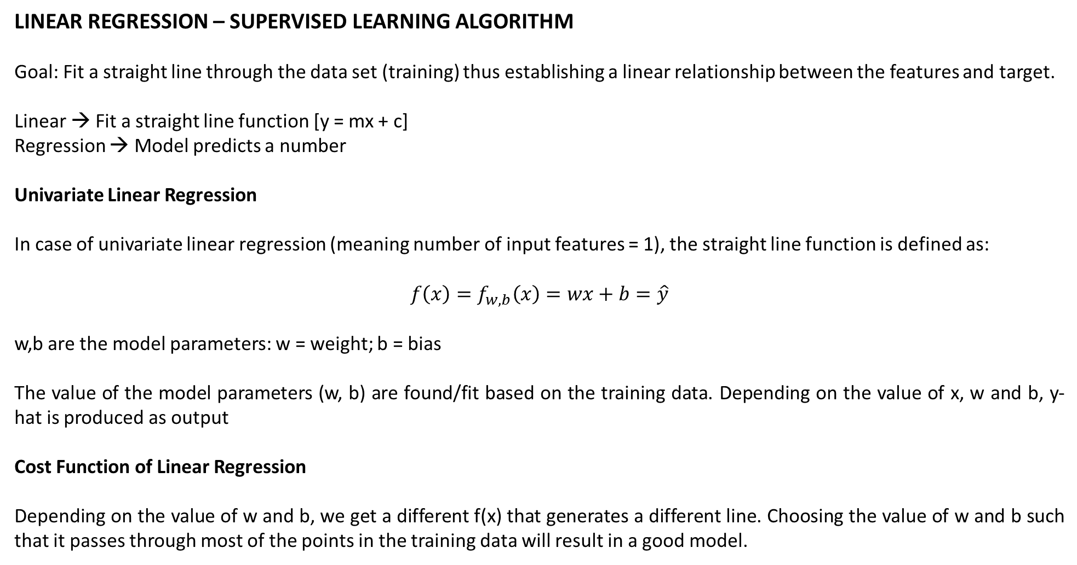
LINEAR REGRESSION – SUPERVISED LEARNING ALGORITHM
Goal: Fit a straight line through the data set (training) thus establishing a linear relationship between the features and target.
Linear → Fit a straight line function [y = mx + c]
Regression → Model predicts a number
Univariate Linear Regression
In case of univariate linear regression (meaning number of input features = 1), the straight line function is defined as:
$$f\left(x\right)=f_{w,b}\left(x\right)=wx+b=\hat{y}$$
w,b are the model parameters: w = weight; b = bias
The value of the model parameters (w, b) are found/fit based on the training data. Depending on the value of x, w and b, y-hat is produced as output
Cost Function of Linear Regression
Depending on the value of w and b, we get a different f(x) that generates a different line. Choosing the value of w and b such that it passes through most of the points in the training data will result in a good model.

Slide 5
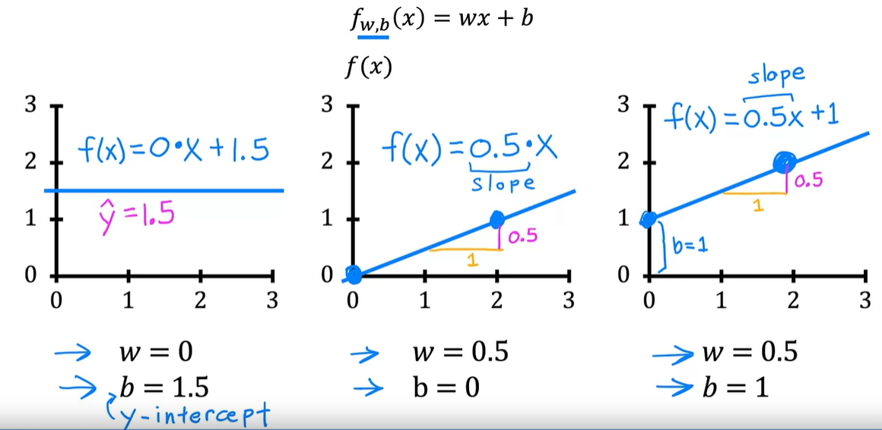
To find the right values of the model parameters (w, b), we fist choose a value of w, b and generate a prediction for the training set. Then, we compare the generated values vs the correct values and measure the model performance using a cost function
Thus, a cost function helps quantify how well the model fits the training data

Slide 6
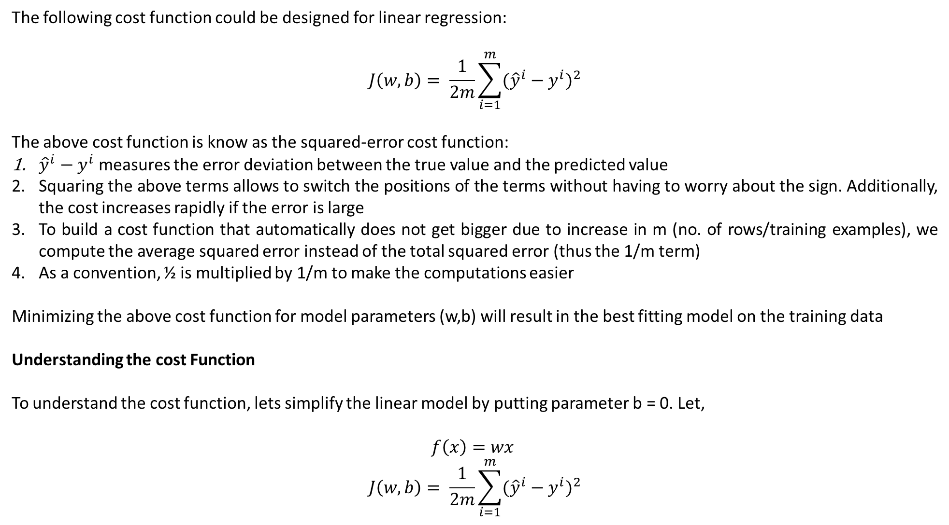
The following cost function could be designed for linear regression:
$$J\left(w,b\right)= \frac{1}{2m}\sum_{i=1}^{m}{{({\hat{y}}^{i}−y^{i})}^{2}}$$
The above cost function is know as the squared-error cost function:
${\hat{y}}^{i}−y^{i}$ measures the error deviation between the true value and the predicted value
Squaring the above terms allows to switch the positions of the terms without having to worry about the sign. Additionally, the cost increases rapidly if the error is large
To build a cost function that automatically does not get bigger due to increase in m (no. of rows/training examples), we compute the average squared error instead of the total squared error (thus the 1/m term)
As a convention, ½ is multiplied by 1/m to make the computations easier
Minimizing the above cost function for model parameters (w,b) will result in the best fitting model on the training data
Understanding the cost Function
To understand the cost function, lets simplify the linear model by putting parameter b = 0. Let,
$$f\left(x\right)=wx$$
$$J\left(w,b\right)= \frac{1}{2m}\sum_{i=1}^{m}{{({\hat{y}}^{i}−y^{i})}^{2}}$$

Slide 7
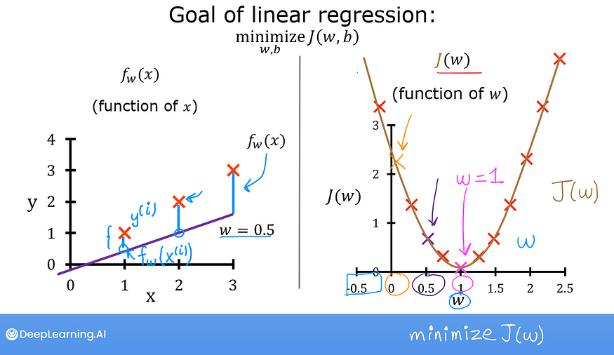
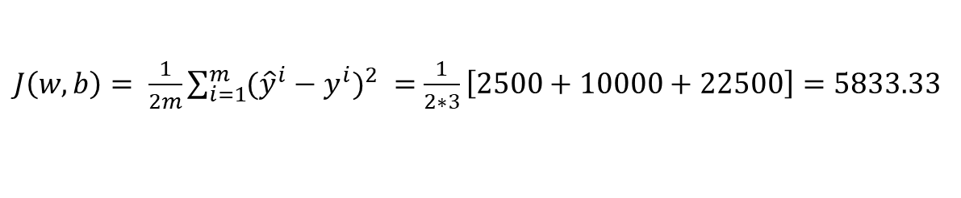
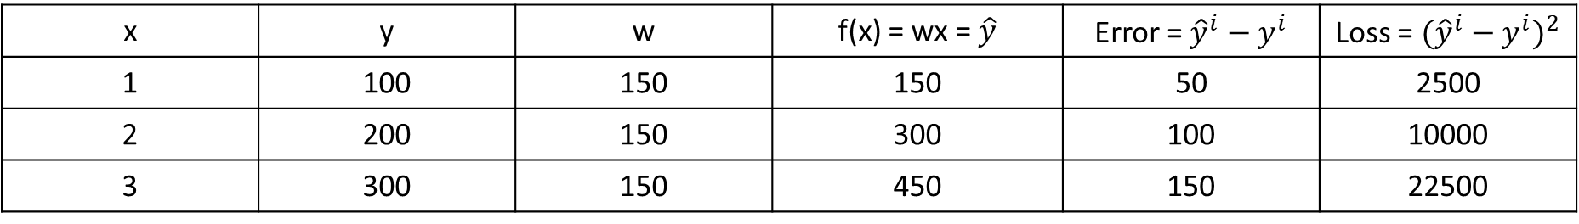
To calculate the best w – choose a value and calculate the cost. Then, systematically iterate over the value to reduce the cost
x | y | w | f(x) = wx = $\hat{y}$ | Error = ${\hat{y}}^{i}−y^{i}$ | Loss = ${({\hat{y}}^{i}−y^{i})}^{2}$
1 | 100 | 150 | 150 | 50 | 2500
2 | 200 | 150 | 300 | 100 | 10000
3 | 300 | 150 | 450 | 150 | 22500
$J\left(w,b\right)= \frac{1}{2m}\sum_{i=1}^{m}{{({\hat{y}}^{i}−y^{i})}^{2}} =$ $\frac{1}{2∗3}\left[2500+10000+22500\right]=5833.33$
Each value of parameter w corresponds to a different straight line fit and hence a different cost as shown below
w=2
w=1.25
y
w=1
o
w=0.75
o
o
w=0.5
x

Slide 8
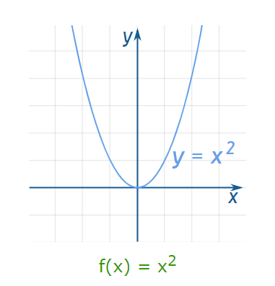
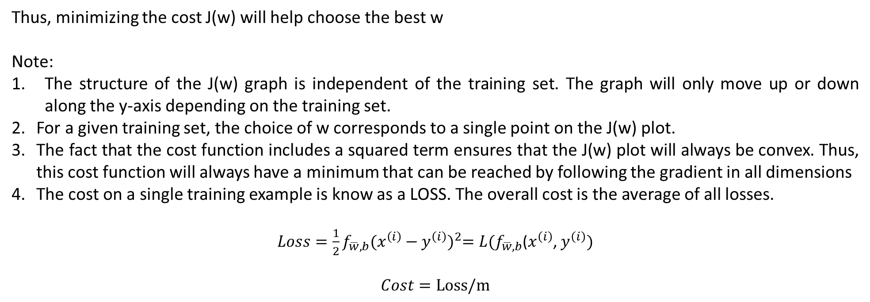
Thus, minimizing the cost J(w) will help choose the best w
Note:
The structure of the J(w) graph is independent of the training set. The graph will only move up or down along the y-axis depending on the training set.
For a given training set, the choice of w corresponds to a single point on the J(w) plot.
The fact that the cost function includes a squared term ensures that the J(w) plot will always be convex. Thus, this cost function will always have a minimum that can be reached by following the gradient in all dimensions
The cost on a single training example is know as a LOSS. The overall cost is the average of all losses.
$Loss=\frac{1}{2}f_{\overline{w},b}{(x^{\left(i\right)}−y^{\left(i\right)})}^{2}=L(f_{\overline{w},b}$($x^{\left(i\right)}$, $y^{\left(i\right)})$
$$Cost=Loss/m$$
NOTE: ½ is included in the loss.
The above plot is a parabola

Slide 9
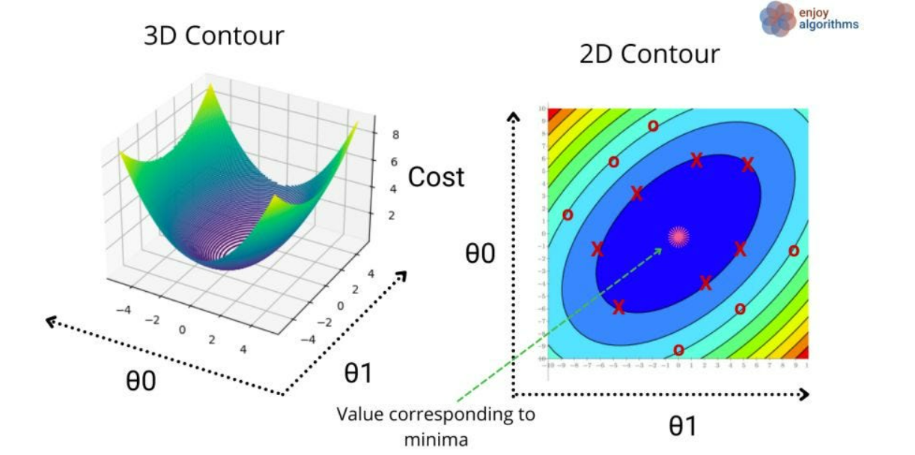
Cost Function for Simple Linear Regression
- In case of linear regression, there are 2 model parameters – w, b
- On performing similar exercise of choosing different values of w & b (corresponding to different straight line fits), the cost function plot for J(w,b) is now a 3D convex bow-shaped plot
- As w and b now vary across 2 different axes, you get a different cost for change in either w or b or both
- The general structure of J(w,b) is independent of the training set. However, the graph can now move along the x-axis or the y-axis (the bow shaped plot can be elongated or squished) depending on the training data
To visualize the 3D cost function plot on a 2D scale, we can use a contour-plot – On horizontally slicing the 3D plot, and getting all points at the same height, each horizontal slice ends up being an ellipse or an oval showing positions having the same value of J(w,b). The minimum is at the center of the smallest oval.

Slide 10
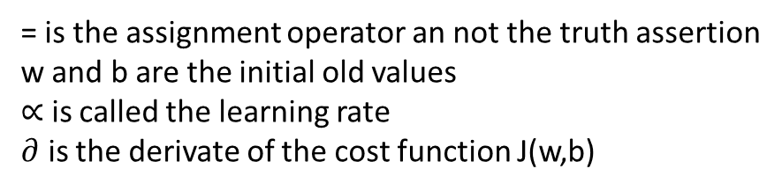
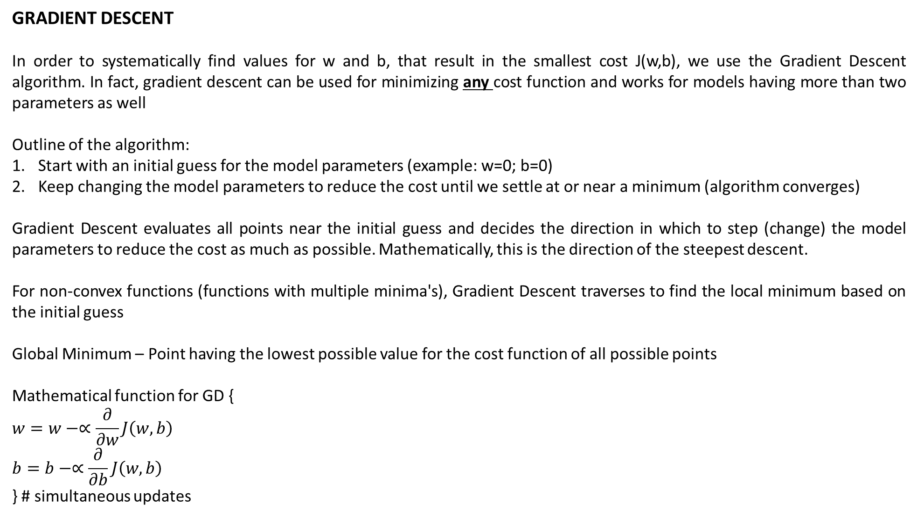
GRADIENT DESCENT
In order to systematically find values for w and b, that result in the smallest cost J(w,b), we use the Gradient Descent algorithm. In fact, gradient descent can be used for minimizing any cost function and works for models having more than two parameters as well
Outline of the algorithm:
Start with an initial guess for the model parameters (example: w=0; b=0)
Keep changing the model parameters to reduce the cost until we settle at or near a minimum (algorithm converges)
Gradient Descent evaluates all points near the initial guess and decides the direction in which to step (change) the model parameters to reduce the cost as much as possible. Mathematically, this is the direction of the steepest descent.
For non-convex functions (functions with multiple minima's), Gradient Descent traverses to find the local minimum based on the initial guess
Global Minimum – Point having the lowest possible value for the cost function of all possible points
Mathematical function for GD {
$$w=w−∝\frac{∂}{∂w}J\left(w,b\right)$$
$$b=b−∝\frac{∂}{∂b}J\left(w,b\right)$$
} # simultaneous updates
= is the assignment operator an not the truth assertion
w and b are the initial old values
$∝$ is called the learning rate
$∂$ is the derivate of the cost function J(w,b)

Slide 11
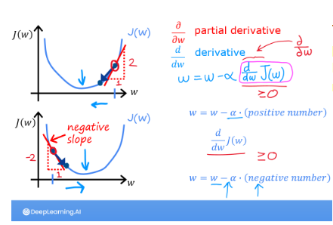
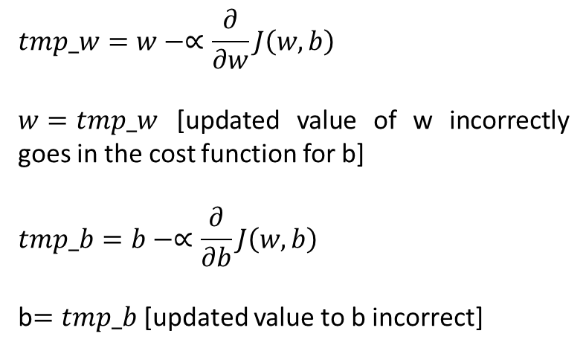
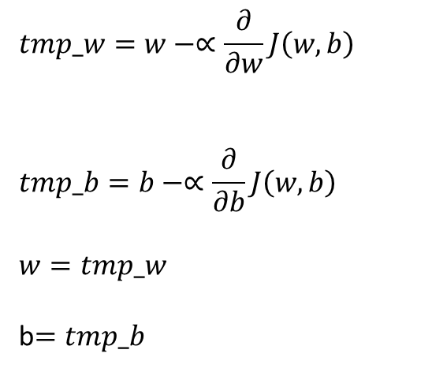
Note on Gradient Descent implementation - The model parameters need to be simultaneously updated and not sequentially:
CORRECT
INCORRECT
$$tmp_w=w−∝\frac{∂}{∂w}J\left(w,b\right)$$
$$tmp_b=b−∝\frac{∂}{∂b}J\left(w,b\right)$$
$$w=tmp_w$$
b$=tmp_b$
$$tmp_w=w−∝\frac{∂}{∂w}J\left(w,b\right)$$
$w=tmp_w$ [updated value of w incorrectly goes in the cost function for b]
$$tmp_b=b−∝\frac{∂}{∂b}J\left(w,b\right)$$
b$=tmp_b$ [updated value to b incorrect]
old value of w

Slide 12
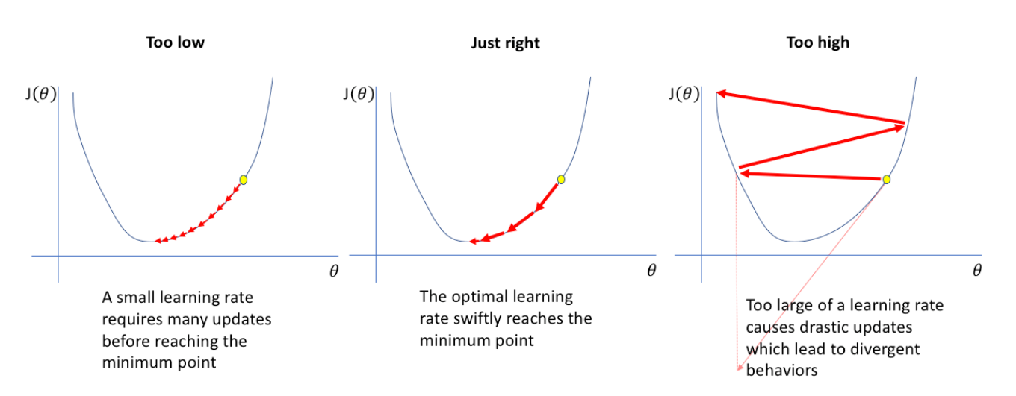
Learning Rate
Controls how big of a step is taken in the direction of the steepest descent
usually a small positive number between 0 and 1. Multiplying by 0 means no effect and 1 means full effect.
has a huge impact on the efficiency of the gradient descent algorithm – if chosen poorly, algorithm might not work well
CASE 1: Learning Rate is too small
This means you multiply the derivative of the cost by a very small number
Thus, a very small step is taken in the direction of the steepest descent
Likewise, each step is miniscule and the cost decreases very slowly, taking more time for the algorithm to converge
However, convergence is somewhat guaranteed!
CASE 2: Learning Rate is too large
Model parameters are updated based on giant steps in the direction of steepest descent
This may cause the algorithm to never converge (diverge) as we can overshoot the minimum value. Also, in this case, the derivative will keep switching signs between the iterations.
Since a small learning rate guarantees convergence, it may be preferred over a larger learning rate.

Slide 13
Derivatives
The derivative determines the direction of the steepest descent/the direction in which to take the step. The sign of the derivative is more important than its value. The value output by the derivative is controlled using the learning rate.
For a fixed learning rate, the further away we are from the local minima, the larger the derivative value. The derivative value output may not be inline with the actual step to be taken in the direction of the descent (the value could be a very high or a very low number). Thus, the derivative is multiplied with the learning rate (between 0 and 1)
As we move closer to the minimum, the derivative will decrease in value. This is an inherent property of the derivative term
The derivative term at the local minimum is 0
Partial derivatives are computed w.r.t. each model parameter
Step
Each step is a combination of the learning rate and derivative (step = learning rate x derivative). The step/updates to the model parameters are non-linear. The step is the value by which the model parameter will be actually changed:
Near the local minima, update steps get smaller because the derivative gets smaller
The learning rate controls the impact of the derivative term (how fast/slow we reach of the local minima)
Derivative = 100
Learning Rate = 0.00001
Step = 0.001
Derivative = 100
Learning Rate = 1
Step = 100
Derivative = 100
Learning Rate = 0.01
Step = 1

Slide 14
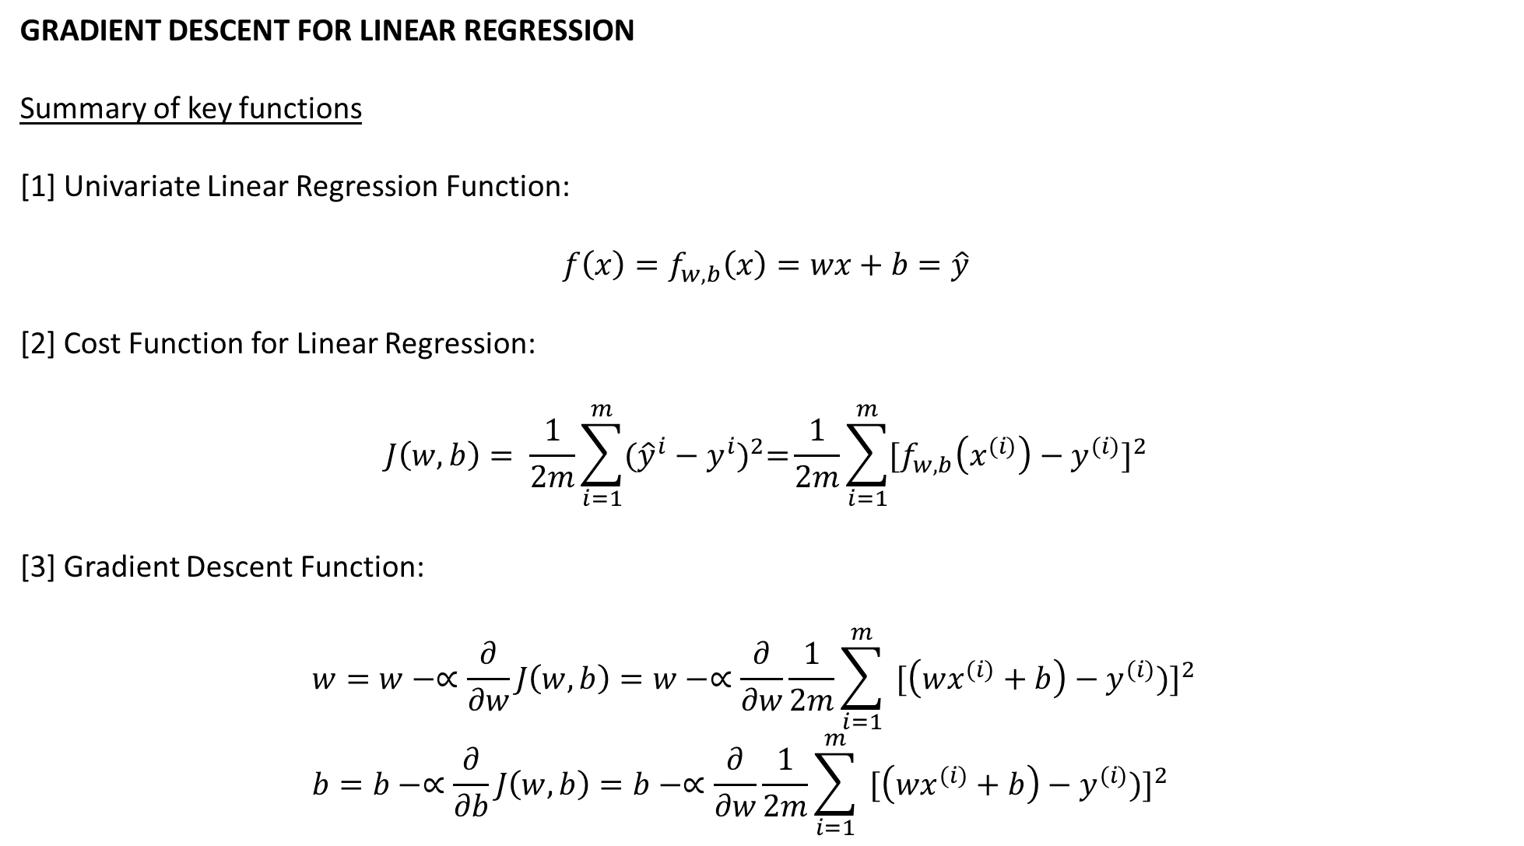
GRADIENT DESCENT FOR LINEAR REGRESSION
Summary of key functions
[1] Univariate Linear Regression Function:
$$f\left(x\right)=f_{w,b}\left(x\right)=wx+b=\hat{y}$$
[2] Cost Function for Linear Regression:
$$J\left(w,b\right)= \frac{1}{2m}\sum_{i=1}^{m}{{({\hat{y}}^{i}−y^{i})}^{2}=}\frac{1}{2m}\sum_{i=1}^{m}{{[f}_{w,b}\left(x^{(i)}\right)−{y^{(i)}]}^{2}}$$
[3] Gradient Descent Function:
$$w=w−∝\frac{∂}{∂w}J\left(w,b\right)=w−∝\frac{∂}{∂w}\frac{1}{2m}\sum_{i=1}^{m}{ [\left(wx^{(i)}+b\right)−{y^{(i)})]}^{2}}$$
$$b=b−∝\frac{∂}{∂b}J\left(w,b\right)=b−∝\frac{∂}{∂w}\frac{1}{2m}\sum_{i=1}^{m}{ [\left(wx^{(i)}+b\right)−{y^{(i)})]}^{2}}$$
Simultaneous
Updates

Slide 15
Derivation of the J(w,b) derivatives:
$$\frac{∂}{∂w}J\left(w,b\right)=\frac{∂}{∂w}\frac{1}{2m}\sum_{i=1}^{m}{ [\left(wx^{\left(i\right)}+b\right)−{y^{\left(i\right)})]}^{2}=}\frac{1}{2m}∗2∗x^{\left(i\right)}\sum_{i=1}^{m}{ \left({wx}^{\left(i\right)}+b\right)−y^{\left(i\right)})=}\frac{1}{m}\sum_{i=1}^{m}{ [\left({wx}^{\left(i\right)}+b\right)−y^{\left(i\right)}]x^{\left(i\right)}}$$
$$\frac{∂}{∂b}J\left(w,b\right)=\frac{∂}{∂b}\frac{1}{2m}\sum_{i=1}^{m}{ [\left(wx^{\left(i\right)}+b\right)−{y^{\left(i\right)})]}^{2}=}\frac{1}{2m}∗2∗1\sum_{i=1}^{m}{ \left({wx}^{\left(i\right)}+b\right)−y^{\left(i\right)})=}\frac{1}{m}\sum_{i=1}^{m}{ [\left({wx}^{\left(i\right)}+b\right)−y^{\left(i\right)}] }$$
Gradient Descent For Linear Regression: {
$$w=w−∝\frac{∂}{∂w}J\left(w,b\right)=w−∝\frac{1}{m}\sum_{i=1}^{m}{ [\left({wx}^{\left(i\right)}+b\right)−y^{\left(i\right)}]x^{\left(i\right)}}=w−∝\frac{1}{m}\sum_{i=1}^{m}{ [{\hat{y}}^{(i)}−y^{\left(i\right)}]x^{\left(i\right)}}$$
$$b=b−∝\frac{∂}{∂b}J\left(w,b\right)=b−∝\frac{1}{m}\sum_{i=1}^{m}{ [\left({wx}^{\left(i\right)}+b\right)−y^{\left(i\right)}] }=b−∝\frac{1}{m}\sum_{i=1}^{m}{ [{\hat{y}}^{(i)}−y^{\left(i\right)}] }$$
} simultaneous updates
The above version of gradient descent is known as “BATCH” gradient descent – each step of gradient descent uses all training examples.
Note – The squared error cost function does not have multiple local minima & has only one global minima. Thus, as long as the learning rate is chose properly, gradient descent will ALWAYS converge to the global minima.

Slide 16


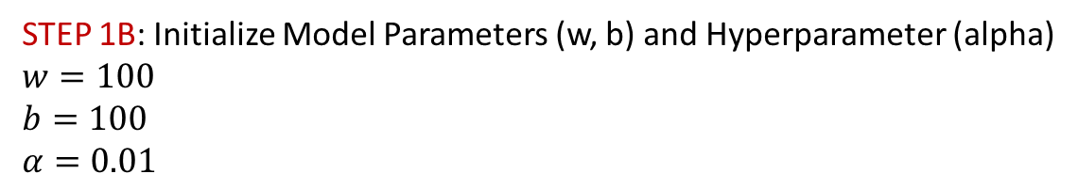
Summary – Simple Linear Regression
STEP 1A: Initialize $f_{w,b}(x)$
Training Set
$${ f}_{w,b}\left(x\right) = w ∗ x + b$$
X | Y
52 | 5308
28 | 6123
44 | 1893
35 | 4208
39 | 5228
Y
5308
6123
1893
4208
5228
X
52
28
44
35
39
$$+ b$$
$$w$$
$$∗$$
$$=$$
STEP 1B: Initialize Model Parameters (w, b) and Hyperparameter (alpha)
$$w=100$$
$$b=100$$
$$α=0.01$$

Slide 17
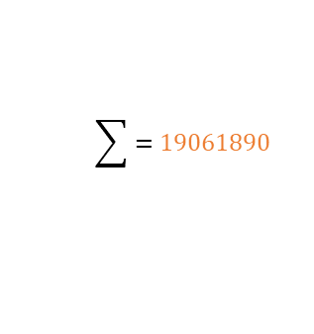
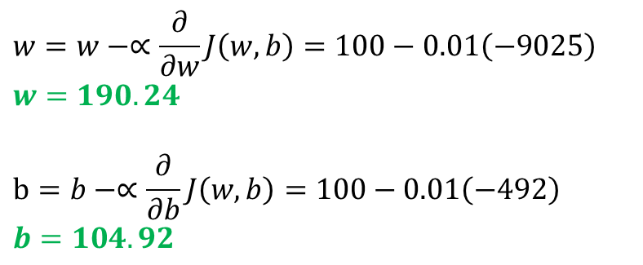
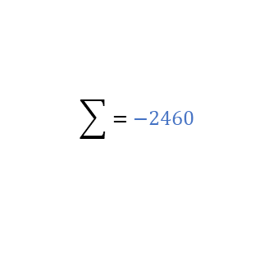
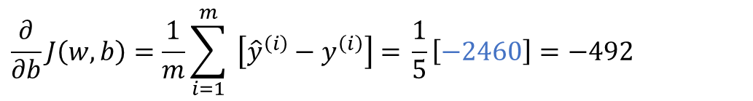
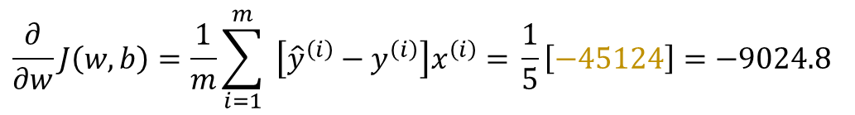
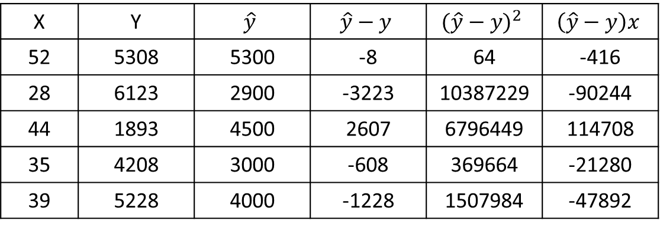

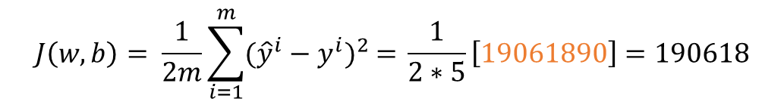
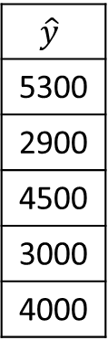
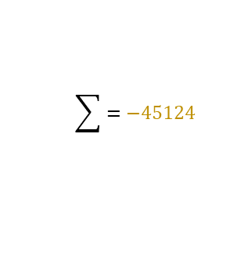
STEP 2: Calculate $\hat{y}$ based on initialized parameters
STEP 4: Calculate Cost
$${ f}_{w,b}\left(x\right) = w ∗ x + b$$
$$\hat{y}$$
$$=$$
$$J\left(w,b\right)= \frac{1}{2m}\sum_{i=1}^{m}{{({\hat{y}}^{i}−y^{i})}^{2} = }\frac{1}{2∗5}\left[19061890\right]=190618$$
Y
5308
6123
1893
4208
5228
X
52
28
44
35
39
$$\hat{y}$$
5300
2900
4500
3000
4000
STEP 5: Calculate Derivatives
$$=$$
$$=$$
$$100 ∗$$
$$+ 100$$
$$\frac{∂}{∂w}J\left(w,b\right)=\frac{1}{m}\sum_{i=1}^{m}{ \left[{\hat{y}}^{\left(i\right)}−y^{\left(i\right)}\right]x^{\left(i\right)}=} \frac{1}{5}\left[−45124\right]=−9024.8$$
$$\frac{∂}{∂b}J\left(w,b\right)=\frac{1}{m}\sum_{i=1}^{m}{ \left[{\hat{y}}^{\left(i\right)}−y^{\left(i\right)}\right]=} \frac{1}{5}\left[−2460\right]=−492$$
STEP 3: Calculate squared error metrics and cost
STEP 6: Update parameters based on learning rate
X | Y | $$\hat{y}$$ | $$\hat{y}−y$$ | $${(\hat{y}−y)}^{2}$$ | $$\left(\hat{y}−y\right)x$$
52 | 5308 | 5300 | -8 | 64 | -416
28 | 6123 | 2900 | -3223 | 10387229 | -90244
44 | 1893 | 4500 | 2607 | 6796449 | 114708
35 | 4208 | 3000 | -608 | 369664 | -21280
39 | 5228 | 4000 | -1228 | 1507984 | -47892
$$w=w−∝\frac{∂}{∂w}J\left(w,b\right)=100−0.01\left(−9025\right)$$
$$w=190.24$$
$$b=b−∝\frac{∂}{∂b}J\left(w,b\right)=100−0.01\left(−492\right)$$
$$b=104.92$$
$$\sum{=−2460}$$
$$\sum{=19061890}$$
$$\sum{=−45124}$$
STEP 7: Repeat Step 1-6 till w & b converge

Slide 18
Vectorization and Code
To compute linear regression, we use the concept of vectorization which makes the code shorter and efficient, and scales well on large datasets
Non-vectorized code would mean looping sequentially over each w * x step and adding b
For the vectorized version, we instead use the numpy dot product implementation which uses parallel hardware on the computer (CPU as well as GPU). Using parallelization, we compute the w*x + b equation for all elements in the training set in one step. CPUs & GPUs implement Single Instruction Multiple Data (SIMD) pipelines allowing multiple operations to be issues in parallel
Similarly, vectorization is used for computing gradients and updating weights
Vectorization is performed using the `numpy` library and structuring the data in vectors and matrices:
Numpy
Python library that extends base capabilities of python by adding additional numeric types, data types & functions
Vectors
Are ordered arrays of numbers
All elements of vectors are of the same type
Elements are referenced using an index (0 to n-1)
Vectors are represented as Numpy 1D arrays
Matrices
2D Numpy arrays in which all elements are of the same data type
Dot product function
Multiples 2 vectors element-wise (and not sequentially) and sums the result in one step
Requires dimensions of the 2 vectors to be the same
Outputs a Scalar

Slide 19
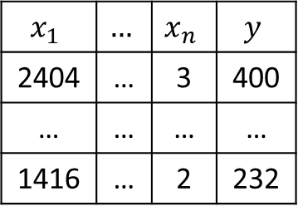
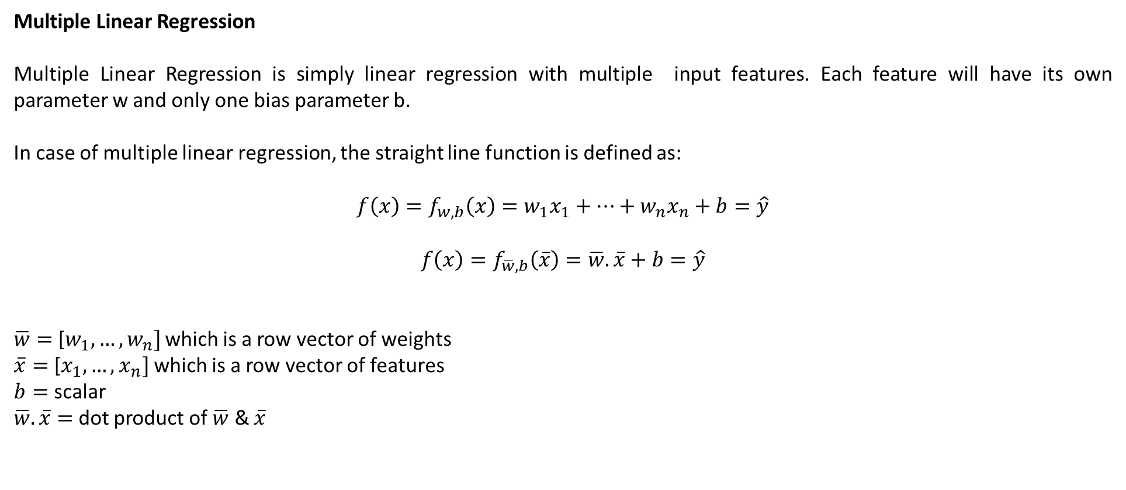
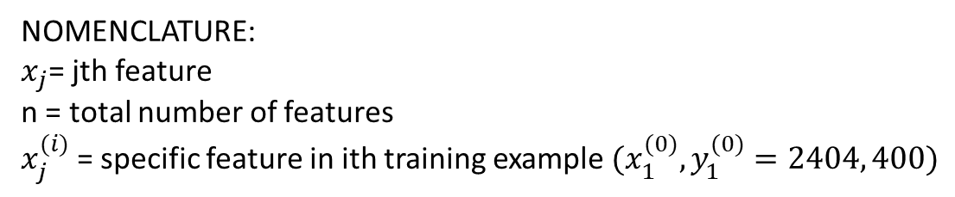
Multiple Linear Regression
Multiple Linear Regression is simply linear regression with multiple input features. Each feature will have its own parameter w and only one bias parameter b.
In case of multiple linear regression, the straight line function is defined as:
$$f\left(x\right)=f_{w,b}\left(x\right)=w_{1}x_{1}+…+w_{n}x_{n}+b=\hat{y}$$
$$f\left(x\right)=f_{\overline{w},b}\left(\overline{x}\right)=\overline{w}.\overline{x}+b=\hat{y}$$
$\overline{w}=$ [$w_{1}, …,w_{n}]$ which is a row vector of weights
$\overline{x}=$ [$x_{1}, …,x_{n}]$ which is a row vector of features
$b=$ scalar
$\overline{w}.\overline{x}=$ dot product of $\overline{w}$ & $\overline{x}$
Training Set - Example
$$x_{1}$$ | $$…$$ | $$x_{n}$$ | $$y$$
2404 | … | 3 | 400
… | … | … | …
1416 | … | 2 | 232
NOMENCLATURE:
$x_{j}$= jth feature
n = total number of features
$x_{j}^{(i)}$= specific feature in ith training example $(x_{1}^{(0)},y_{1}^{(0)}=2404, 400)$

Slide 20
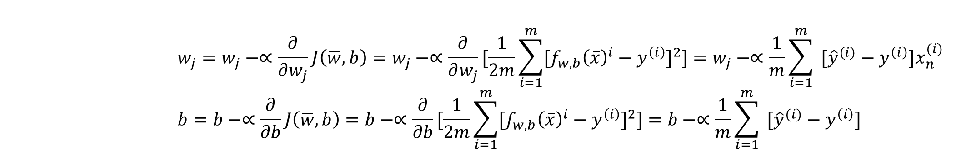
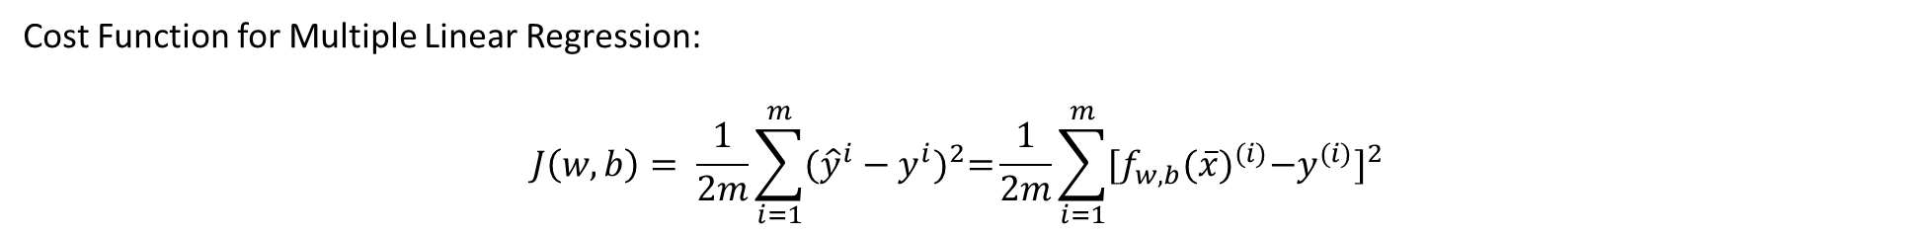
Cost Function for Multiple Linear Regression:
$$J\left(w,b\right)= \frac{1}{2m}\sum_{i=1}^{m}{{({\hat{y}}^{i}−y^{i})}^{2}=}\frac{1}{2m}\sum_{i=1}^{m}{{[f}_{w,b}{(\overline{x})}^{(i)}−{y^{(i)}]}^{2}}$$
Gradient Descent for Multiple Linear Regression:
$$w_{j}=w_{j}−∝\frac{∂}{∂w_{j}}J\left(\overline{w},b\right)=w_{j}−∝\frac{∂}{∂w_{j}}[\frac{1}{2m}\sum_{i=1}^{m}{{[f}_{w,b}{\left(\overline{x}\right)}^{i}−{y^{\left(i\right)}]}^{2}]}=w_{j}−∝\frac{1}{m}\sum_{i=1}^{m}{ [{\hat{y}}^{(i)}−y^{\left(i\right)}]x_{n}^{(i)} }$$
$$b=b−∝\frac{∂}{∂b}J\left(\overline{w},b\right)=b−∝\frac{∂}{∂b}[\frac{1}{2m}\sum_{i=1}^{m}{{[f}_{w,b}{\left(\overline{x}\right)}^{i}−{y^{\left(i\right)}]}^{2}]}=b−∝\frac{1}{m}\sum_{i=1}^{m}{ [{\hat{y}}^{(i)}−y^{\left(i\right)}] }$$

Slide 21
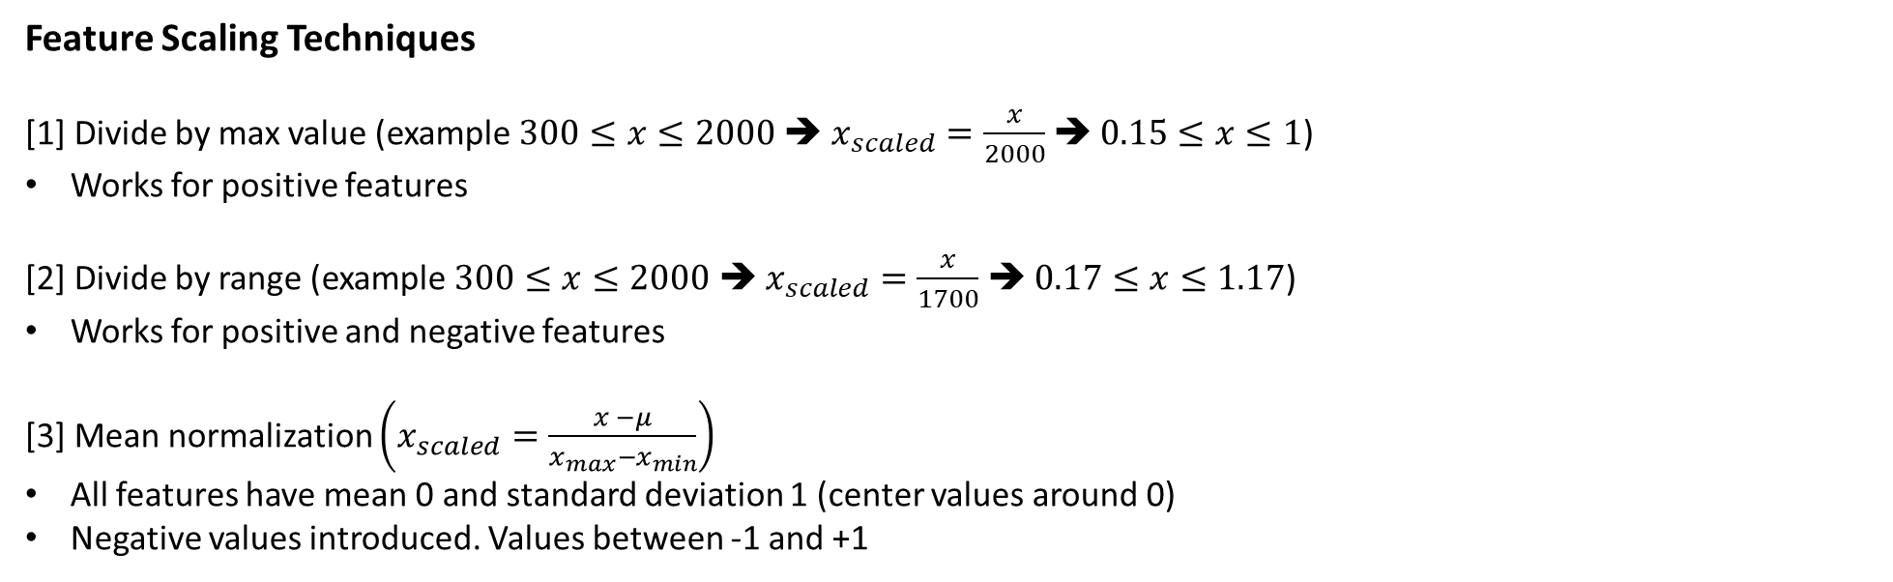
Feature Scaling
- In order for gradient descent to run much faster, it is beneficial to re-scale features so that they can take a comparable range of values
- If the range of values is large, it is more likely that a good model will learn to choose relatively small parameter values and vice-versa. To explain further, if feature X has a very large range, a small change in W can have a very large impact on the output because W will be multiplied by a large number. In contrast, if X is very small, it takes a much larger change in W to change the predictions
- Situations like the above will increase the number of steps that the algorithm will take to converge. Scaling the features helps gradient descent find a more direct path to the global minimum
Feature Scaling Techniques
[1] Divide by max value (example $300≤x≤2000$ ➔ $x_{scaled}=\frac{x}{2000}$ ➔ $0.15≤x≤1$)
Works for positive features
[2] Divide by range (example $300≤x≤2000$ ➔ $x_{scaled}=\frac{x}{1700}$ ➔ $0.17≤x≤1.17$)
Works for positive and negative features
[3] Mean normalization $\left(x_{scaled}=\frac{x −μ}{x_{max}−x_{min}}\right)$
All features have mean 0 and standard deviation 1 (center values around 0)
Negative values introduced. Values between -1 and +1

Slide 22
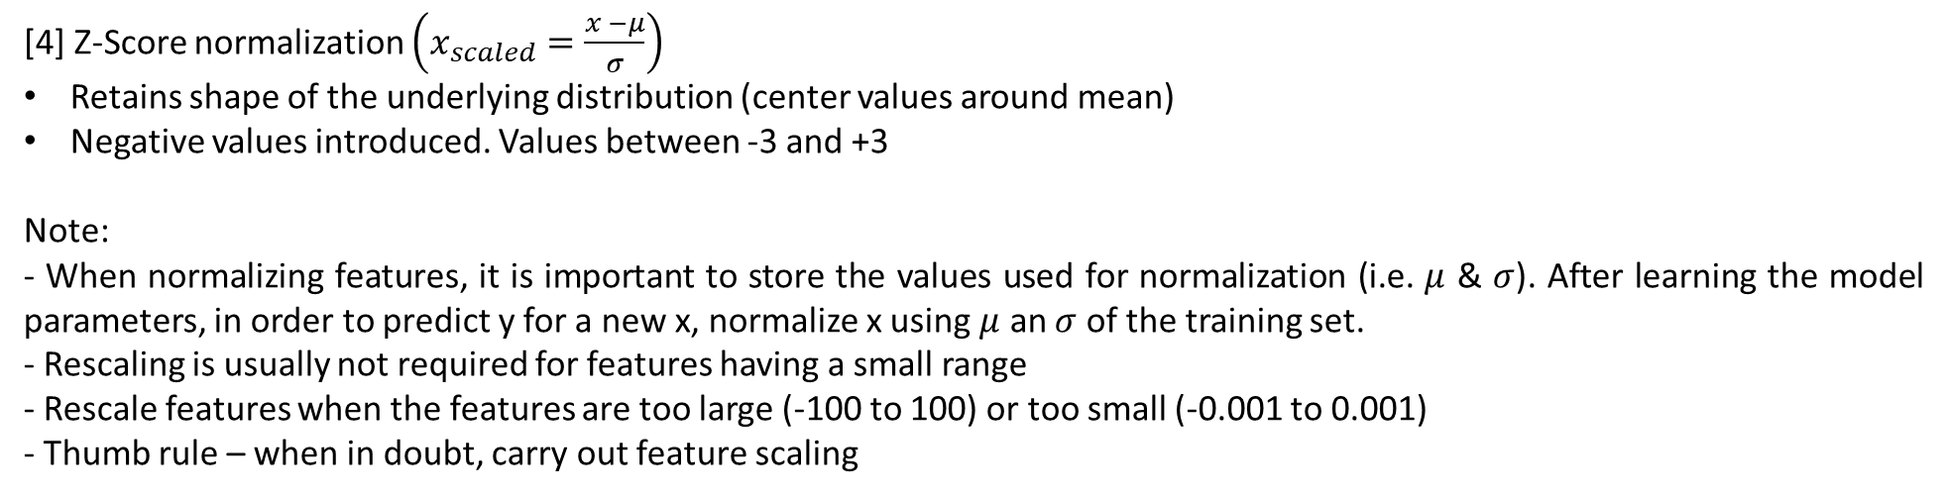
[4] Z-Score normalization $\left(x_{scaled}=\frac{x −μ}{σ}\right)$
Retains shape of the underlying distribution (center values around mean)
Negative values introduced. Values between -3 and +3
Note:
- When normalizing features, it is important to store the values used for normalization (i.e. $μ$ & $σ$). After learning the model parameters, in order to predict y for a new x, normalize x using $μ$ an $σ$ of the training set.
- Rescaling is usually not required for features having a small range
- Rescale features when the features are too large (-100 to 100) or too small (-0.001 to 0.001)
- Thumb rule – when in doubt, carry out feature scaling

Slide 23
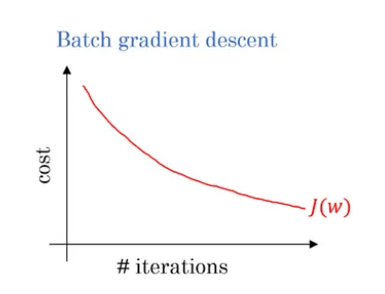
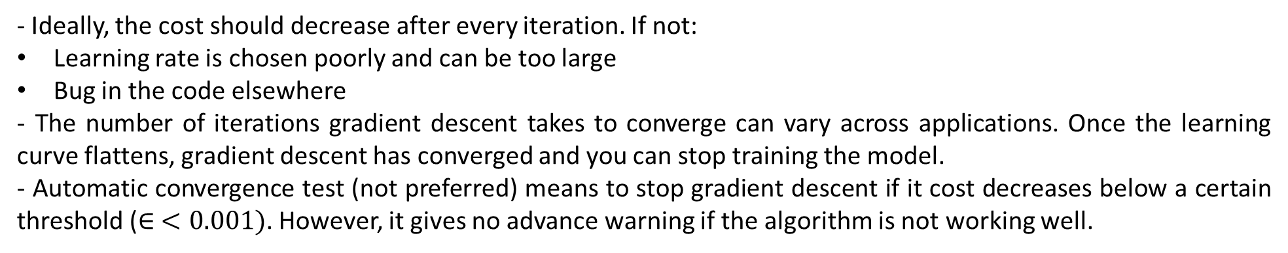
Checking Gradient Descent For Convergence
- Converge means gradient descent is helping you find model parameters close to the global minimum for the cost function
- To check for convergence, plot the learning curve – plot the cost J for each iteration of gradient descent after simultaneous update of model parameters
- Ideally, the cost should decrease after every iteration. If not:
Learning rate is chosen poorly and can be too large
Bug in the code elsewhere
- The number of iterations gradient descent takes to converge can vary across applications. Once the learning curve flattens, gradient descent has converged and you can stop training the model.
- Automatic convergence test (not preferred) means to stop gradient descent if it cost decreases below a certain threshold ($∈ <0.001)$. However, it gives no advance warning if the algorithm is not working well.

Slide 24
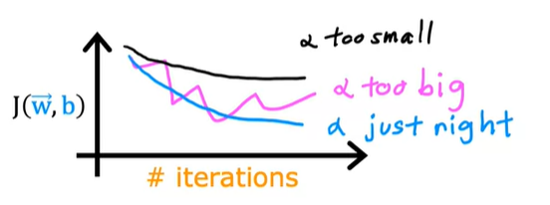
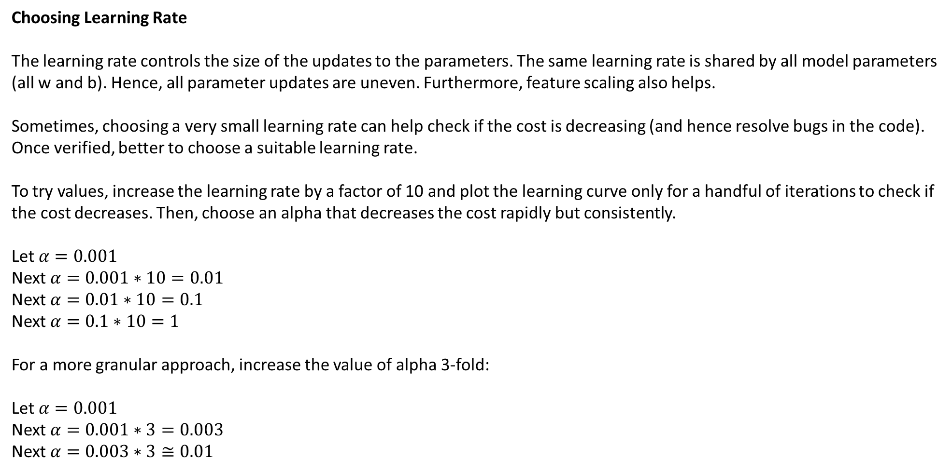
Choosing Learning Rate
The learning rate controls the size of the updates to the parameters. The same learning rate is shared by all model parameters (all w and b). Hence, all parameter updates are uneven. Furthermore, feature scaling also helps.
Sometimes, choosing a very small learning rate can help check if the cost is decreasing (and hence resolve bugs in the code). Once verified, better to choose a suitable learning rate.
To try values, increase the learning rate by a factor of 10 and plot the learning curve only for a handful of iterations to check if the cost decreases. Then, choose an alpha that decreases the cost rapidly but consistently.
Let $α=0.001$
Next $α=0.001∗10=0.01$
Next $α=0.01∗10=0.1$
Next $α=0.1∗10=1$
For a more granular approach, increase the value of alpha 3-fold:
Let $α=0.001$
Next $α=0.001∗3=0.003$
Next $α=0.003∗3≅0.01$

Slide 25
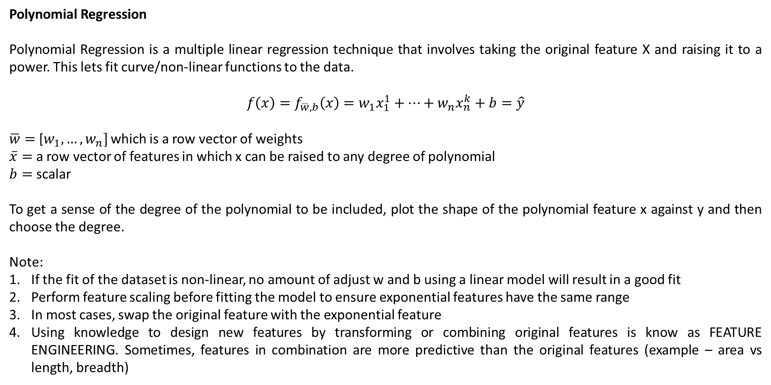
Polynomial Regression
Polynomial Regression is a multiple linear regression technique that involves taking the original feature X and raising it to a power. This lets fit curve/non-linear functions to the data.
$$f\left(x\right)=f_{\overline{w},b}\left(x\right)=w_{1}x_{1}^{1}+…+w_{n}x_{n}^{k}+b=\hat{y}$$
$\overline{w}=$ [$w_{1}, …,w_{n}]$ which is a row vector of weights
$\overline{x}=$ a row vector of features in which x can be raised to any degree of polynomial
$b=$ scalar
To get a sense of the degree of the polynomial to be included, plot the shape of the polynomial feature x against y and then choose the degree.
Note:
If the fit of the dataset is non-linear, no amount of adjust w and b using a linear model will result in a good fit
Perform feature scaling before fitting the model to ensure exponential features have the same range
In most cases, swap the original feature with the exponential feature
Using knowledge to design new features by transforming or combining original features is know as FEATURE ENGINEERING. Sometimes, features in combination are more predictive than the original features (example – area vs length, breadth)

Slide 26
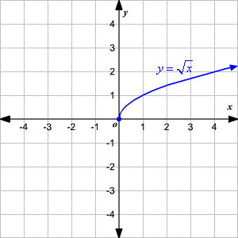
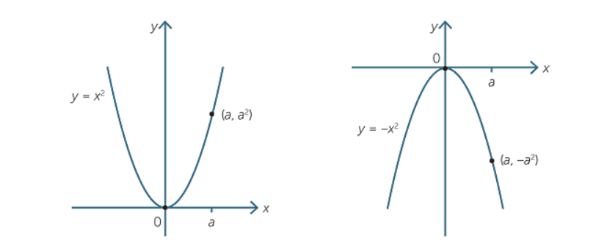
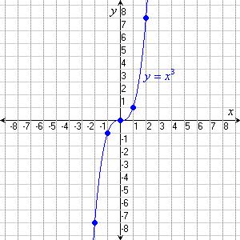
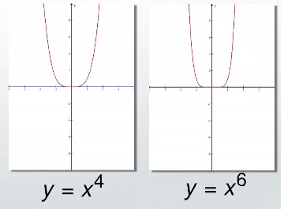
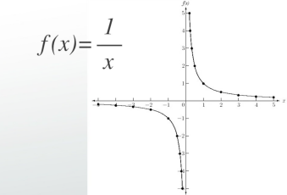
Understanding the nature of quadratic curves

Slide 27
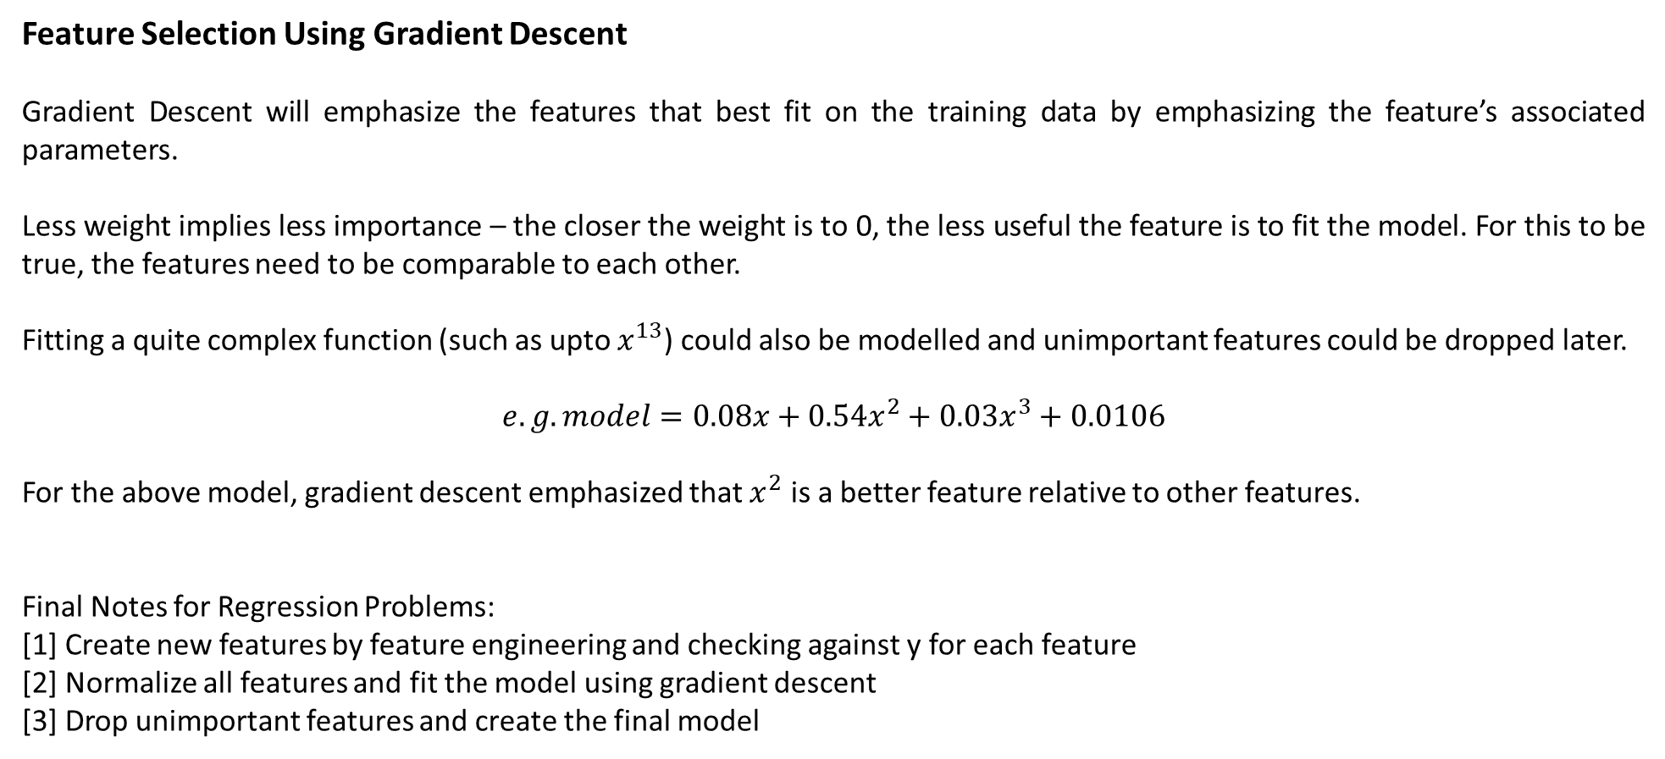
Feature Selection Using Gradient Descent
Gradient Descent will emphasize the features that best fit on the training data by emphasizing the feature’s associated parameters.
Less weight implies less importance – the closer the weight is to 0, the less useful the feature is to fit the model. For this to be true, the features need to be comparable to each other.
Fitting a quite complex function (such as upto $x^{13}$) could also be modelled and unimportant features could be dropped later.
$$e.g. model=0.08x+0.54x^{2}+0.03x^{3}+0.0106$$
For the above model, gradient descent emphasized that $x^{2}$ is a better feature relative to other features.
Final Notes for Regression Problems:
[1] Create new features by feature engineering and checking against y for each feature
[2] Normalize all features and fit the model using gradient descent
[3] Drop unimportant features and create the final model

Slide 28
Logistic Regression
Logistic Regression is a classification algorithm in which the output label Y can take up only a handful of possible values (called classes or categories) instead of any value from an infinite range of numbers. The classes/categories are often encoded to (discrete) numbers before fitting the model.
Linear Regression is not a good algorithm for classification problems because:
Linea Regression’s best fit line can shift (drastically) on addition of new training (classification) examples
Linear Regression can output a value outside of the range of the encoded classes.
Binary Classification
If there are only two possible values for output Y, then the classification problem is know as a binary classification problem. In this case, the output labels are often encoded as ‘1’ for the True or the Positive class and ‘0’ for the False or Negative class.
In case of more than 2 categories, the prediction category of interest in encoded as ‘1’ and the rest of the categories as ‘0’. Hence, for training sets in which there are multiple output classes, the dataset is first converted to a binary classification problem before fitting the logistic model.

Slide 29
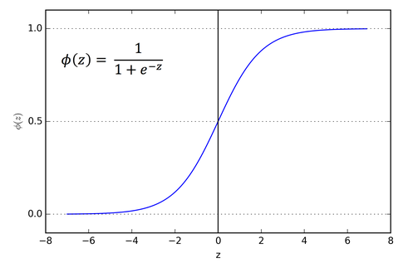
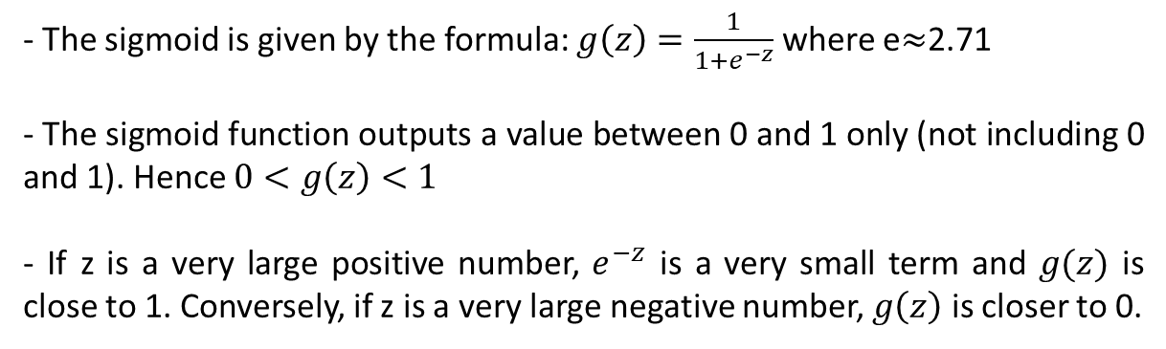
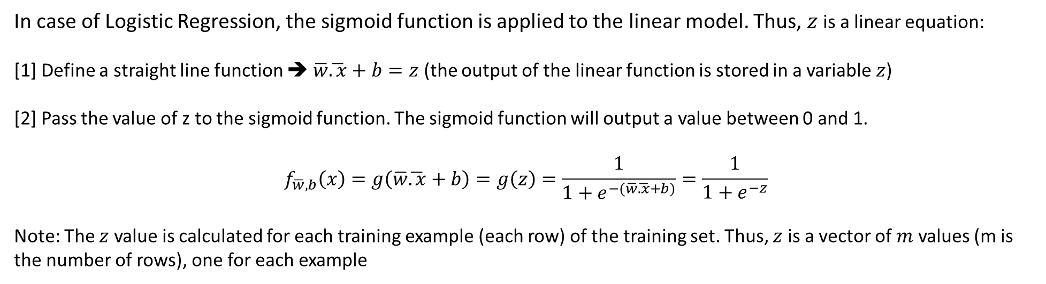
Logistic Regression is built using a mathematical function called the SIGMOID FUNCTION
- The sigmoid is given by the formula: $g\left(z\right)=\frac{1}{1+e^{−z}}$ where e$≈$2.71
- The sigmoid function outputs a value between 0 and 1 only (not including 0 and 1). Hence $0<g\left(z\right)<1$
- If z is a very large positive number, $e^{−z}$ is a very small term and $g(z)$ is close to 1. Conversely, if z is a very large negative number, $g\left(z\right)$ is closer to 0.
In case of Logistic Regression, the sigmoid function is applied to the linear model. Thus, $z$ is a linear equation:
[1] Define a straight line function ➔ $\overline{w}\overline{.x}+b=z$ (the output of the linear function is stored in a variable $z$)
[2] Pass the value of z to the sigmoid function. The sigmoid function will output a value between 0 and 1.
$$f_{\overline{w},b}\left(x\right)=g\left(\overline{w}\overline{.x}+b\right)=g\left(z\right)=\frac{1}{1+e^{−(\overline{w}\overline{.x}+b)}}=\frac{1}{1+e^{−z}}$$
Note: The $z$ value is calculated for each training example (each row) of the training set. Thus, $z$ is a vector of $m$ values (m is the number of rows), one for each example

Slide 30
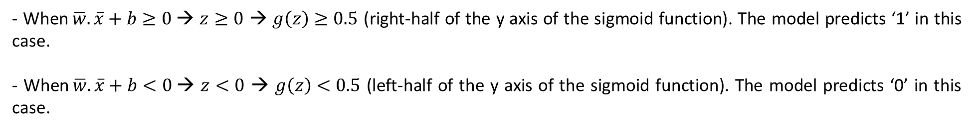


[3] Interpret the output of the logistic regression model as the probability that the class/label Y will be 1 given the input X and parameters w and b [after finding the final parameters w, b]
$$f_{\overline{w},b}\left(x\right)=P(Y=1|\overline{x};\overline{w},b)$$
[4] Map the predicted probability of the logistic regression model to the final label Y. Do so by creating a decision boundary (threshold above which the probability will be mapped to Y; after finding the final parameters w, b)
Decision Boundary
A natural decision boundary (aka threshold) to classify the predicted probability score to output label ‘1’ or ‘0’ is $z=0$:
- When$\overline{w}.\overline{x}+b≥0$→ $z≥0$ → $g\left(z\right)≥0.5$ (right-half of the y axis of the sigmoid function). The model predicts ‘1’ in this case.
- When$\overline{w}.\overline{x}+b<0$→ $z<0$ → $g\left(z\right)<0.5$ (left-half of the y axis of the sigmoid function). The model predicts ‘0’ in this case.
Hence, $\overline{w}.\overline{x}+b=0$ gives a possible decision boundary since $z=0$ becomes the neutral point in the sigmoid function. Lastly, it is possible to use a different threshold (instead of $z=0;g\left(z\right)=0.5$) to classify the final output label as ‘1’. This is because the output of the logistic function is only a probability score, however, the final classification of the probability score can be different from 0.5.

Slide 31

Linear equation $\overline{w}.\overline{x}+b$ results in a linear decision boundary. For non linear decision boundaries, use polynomial equations to fit the data. Examples –
[1] $f_{\overline{w},b}\left(x\right)=g\left(z\right)= g\left(w_{1}x_{1}+w_{2}x_{2}+b\right);$ Decision Boundary ➔ $z=\left(w_{1}x_{1}+w_{2}x_{2}+b\right)=0$; Decision boundary is a line.
[2] $f_{\overline{w},b}\left(x\right)=g\left(z\right)= g\left(w_{1}x_{1}^{2}+w_{2}x_{2}^{2}+b\right);$ Decision Boundary ➔ $z=\left(w_{1}x_{1}^{2}+w_{2}x_{2}^{2}+b\right)=0$; Decision boundary is a circle.
[3] $f_{\overline{w},b}\left(x\right)=g\left(z\right)= g\left(w_{1}x_{1}+w_{2}x_{2}+w_{3}x_{1}^{2}+w_{4}x_{1}x_{2}+w_{5}x_{x}^{2}+b\right);$ Decision boundary is an ellipse.

Slide 32

Note:
- Raising to higher order polynomials will result in a more complex non-linear decision boundary
- Deciding the right features determines the final decision boundary and is essential for the logistic regression model to fit well. This is also true for linear regression.
Thus, the range of logistic regression models depends on the linearity/non-linearity of the equation $z$
Cost Function For Logistic Regression
Recall: Cost function gives a way to measure how well a specific set of parameters fit the training data, thereby giving a way to choose better parameters
: The squared-error cost function has a nice property that following the derivative of the cost function leads to the global minimum
: The cost on a single training example is know as the Loss. The loss is denoted by Capital L and is a function of the prediction of the learning algorithm
: Summing up the loss of all training examples and averaging them results in the Cost
The squared error cost function does not work for logistic regression because the non-linear nature of logistic regression results in a non-convex function with many potential local minima. Thus, logistic regression requires a new cost function which is more suitable for its non-linear nature.
A new cost function is derived for logistic regression using maximum likelihood estimation

Slide 33

Logistic Loss Function:
$$L(f_{\overline{w},b}\left(x^{\left(i\right)},y^{\left(i\right)}\right)=−y^{\left(i\right)}\log\left(f_{\overline{w},b}\left(x^{\left(i\right)}\right)\right)−\left(1−y^{\left(i\right)}\right)log⁡(1−f_{\overline{w},b}\left(x^{\left(i\right)}\right))$$
$ify^{\left(i\right)}=1$ ➔$L=−1log⁡(f\left(x^{\left(i\right)}\right))$
$ify^{\left(i\right)}=0$ ➔$L=−1\log\left(1−f\left(x^{\left(i\right)}\right)\right)$
$$Cost J\left(\overline{w},b\right)=\frac{1}{m}\sum_{i=1}^{m}{[L\left(f_{\overline{w},b}\left(x^{\left(i\right)},y^{\left(i\right)}\right)\right]=}\frac{−1}{m}\sum_{i=1}^{m}{[y^{\left(i\right)}\log\left(f_{\overline{w},b}\left(x^{\left(i\right)}\right)\right)+\left(1−y^{\left(i\right)}\right)log⁡(1−f_{\overline{w},b}\left(x^{\left(i\right)}\right)) }$$
The defining feature of this cost function is that it has 2 separate curves – one for Y=0 and the other for Y=1.
Combined, these curves provide the behavior useful for a cost function – being 0 when the prediction matches the target and rapidly increasing in value as the prediction differs from the target.
Combined, these curves are similar to the quadratic curve of the squared error cost function. Thus, the new cost function does not have any plateaus, local minima or discontinuity. Also, this is NOT bowl shaped like the squared error cost function, but is a curve with declining cost.

Slide 34







Case 1: When Y = 1 ➔
Since the output of logistic regression is always between 0 and 1, the only part of the –log(x) function that is relevant for calculating the loss if the part where $x>0 \& x<1$
If the algorithm predicts a probability close to 1 and the true label is 1, the cost will be very small and the loss will be lowest. Vice versa
➔
$As f_{\overline{w},b}(x^{(i)})$ → $1$ then loss → $0$
$As f_{\overline{w},b}(x^{(i)})$ → $0$ then loss → $Inf$
Case 2: When Y = 0 ➔
Since the output of logistic regression is always between 0 and 1, the only part of the log(x) function that is relevant for calculating the loss if the part where $x<1 \& x>0$
When the output label is 1, the algorithm is strongly incentivized not to predict 0
➔
$As f_{\overline{w},b}(x^{(i)})$ → $1$ then loss → $Inf$
$As f_{\overline{w},b}(x^{(i)})$ → $0$ then loss → $0$

Slide 35


Gradient Descent For Logistic Regression
To fit the parameters of the logistic regression model, we will find the values of w and b that minimize the cost function using gradient descent
Mathematical function for GD {
$$w=w−∝\frac{∂}{∂w} J\left(w,b\right)$$
$$b=b−∝\frac{∂}{∂b} J\left(w,b\right)$$
} # simultaneous updates
After applying calculus, we can show that:
$$\frac{∂}{∂w} J\left(w,b\right)=\frac{1}{m}\sum_{i=1}^{m}{ [f_{\overline{w},b}\left(x^{\left(i\right)}\right)−y^{\left(i\right)}]x_{j}^{(i)} }$$
$$\frac{∂}{∂b} J\left(w,b\right)=\frac{1}{m}\sum_{i=1}^{m}{ [f_{\overline{w},b}\left(x^{\left(i\right)}\right)−y^{\left(i\right)}] }$$
On the surface, the above equation looks same for linear and logistic regression. However, the definition of f(x) has changed:
Linear Regression: $f_{\overline{w},b}\left(x\right)= \overline{w}.x+b$
Logistic Regression: $f_{\overline{w},b}\left(x\right)=\frac{1}{1+e^{−\overline{(w}.x + b)}}$

Slide 36
Overfitting
When the learning algorithm does not fit the training data well, this is called UNDERFITTING or HIGH BIAS. This means there is a clear pattern in the training data that the algorithm is not able to capture
When the learning algorithm fits the training data very well (very low cost achieved), but does not generalize well on making predictions on the test data, we say the model has OVERFIT or has a HIGH VARIANCE. High variance means highly variable predictions – if the training data was just a little bit different, the function (or model parameters) the algorithm fits can end up being totally different and thus generate highly variable predictions
The idea that the learning algorithm does well on test data is called GENERALIZATION. A right model neither has a high bias or a high variance. Fitting the data well or not well is a result of doing well on the TEST set.
If there are too many features, the model generally fits the training data well causing a high variance problem. On the flip side, if a model has too few features, the model underfits and has a high bias.
Technically, underfitting and overfitting is a function of the following:
The number of features
Fitting higher order polynomials
Linear vs Non-Linear model in case of linear regression
Linear vs Non-Linear (complex) decision boundary in case of logistic regression
To address underfitting: Fit a more complex model or add new features

Slide 37


To address overfitting:
[1] Increase the number of training examples (get more training data)
- With a larger training set, we can fit a learning algorithm that is not overly complex
- Extreme examples (which are not outliers) can increase overfitting
- Nominal examples can reduce overfitting
[2] Use fewer features/feature selection
- Use less polynomial features
- Use a limited number of features, especially when the training data is limited
[3] Regularization – This is a technique to reduce the impact of features without eliminating them outright
- Regularization prevents features from having an overly large effect
- Regularization is generally performed on model parameters and not the bias term (b). In practice, regularization makes very little difference on the bias term
Cost Function With Regularization
To apply regularization, you modify the cost function of the learning algorithm in such a way that you modify the weights. A smaller weight/value of the parameters is more like having a simple model – the effect of each feature is less and even. This reduces overfitting.
During regularization, we may not know which features to penalize – thus, we penalize all the model parameters ($W_{j}$) which results in fitting a smoother/simpler model less prone to overfitting

Slide 38

To penalize the features, we add the following term to the cost function:
$$\frac{λ}{2m}\sum_{j=1}^{n}{W_{j}^{2}}$$
$λ$ is a new regularization parameter that has to be tuned along with $α$ (learning rate)
By convention, we divide by 2m to make it easier to choose a lambda value – even if the training set increase in size, the lambda value is more likely to work because of the extra 2m scaling
Thus, the cost function with regularization will be the following:
$$Cost J\left(\overline{w},b\right)=\frac{1}{m}\sum_{i=1}^{m}{[L\left(f_{\overline{w},b}\left(x^{\left(i\right)},y^{\left(i\right)}\right)\right]+}\frac{λ}{2m}\sum_{j=1}^{n}{W_{j}^{2}}$$
Using the modified cost function, we minimize the regularized cost and the original cost. This new cost trades for the following:
[1] Trying to minimize the original cost encourages the learning algorithm to fit the training data well
[2] Trying to minimize the regularization term, the algorithm keeps the model parameters ($W_{j}$) small, which will tend to reduce overfitting
Thus, the value of lambda helps balance between the 2 goals.
Choosing $λ$
[1] If lambda = 0 → no regularization thus chances of overfitting
[2] If lambda = ${10}^{10}$(very high) → the only way to minimize cost will be to ensure $W_{j}$ will be close to 0 (thus underfitting the data because each individual parameter will have no effect)

Slide 39

Thus, adding a regularization term is like adding a base irreducible cost, which in turn penalizes the model weights.
The best practice is to choose a value of $λ$ between 0 and 1: [0, 0.2, 0.4, 0.6, 0.8, 1]
Regularization Intuition
Fitting higher order polynomials generally overfits the data. Regularization is a way to reduce the impact of the higher order polynomial terms by making their parameters/weights really small. Illustrative example:
$$\frac{1}{m}\sum_{i=1}^{m}{[L\left(f_{\overline{w},b}\left(x^{\left(i\right)},y^{\left(i\right)}\right)\right]+}1000W_{x}^{2}+1000W_{y}^{3}$$
With the modified cost function, we penalize the cost function since $W_{x,y}$ are large. This is because, in order to minimize the cost function, the only way to make the new cost smaller is by making $W_{x,y}$ smaller and reducing the overall cost. Thus, we are cancelling the effect of these features and adding a high regularization to each model/weight.
Regularized Linear Regression
$$J\left(w,b\right)= \frac{1}{2m}\sum_{i=1}^{m}{{({\hat{y}}^{i}−y^{i})}^{2} + \frac{λ}{2m}\sum_{j=1}^{n}{W_{j}^{2}}}$$
NOTE: The gradient descent update functions remain the same, however, the expression of derivatives w.r.t. $W_{j}$ changes

Slide 40




$$\frac{∂}{∂w}J\left(w,b\right)=\frac{1}{m}\sum_{i=1}^{m}{ [\left({wx}^{\left(i\right)}+b\right)−y^{\left(i\right)}]x^{\left(i\right)}}+ \frac{λ}{m}W_{j}=\frac{1}{m}\sum_{i=1}^{m}{ [{\hat{y}}^{(i)}−y^{\left(i\right)}]x^{\left(i\right)}}+ \frac{λ}{m}W_{j}$$
$$\frac{∂}{∂b}J\left(w,b\right)=\frac{1}{m}\sum_{i=1}^{m}{ [\left({wx}^{\left(i\right)}+b\right)−y^{\left(i\right)}] }=\frac{1}{m}\sum_{i=1}^{m}{ [{\hat{y}}^{(i)}−y^{\left(i\right)}] }$$
Gradient Descent for Multiple Linear Regression:
$$w_{j}=w_{j}−∝\frac{∂}{∂w_{j}}J\left(\overline{w},b\right)=w_{j}−∝[\frac{1}{m}\sum_{i=1}^{m}{ \left[{\hat{y}}^{\left(i\right)}−y^{\left(i\right)}\right]x_{n}^{\left(i\right)}+\frac{λ}{m}w_{j}]}=w_{j}\left(1−\frac{λ}{m}∝\right)+\sum_{i=1}^{m}{\left[{\hat{y}}^{\left(i\right)}−y^{\left(i\right)}\right]x_{n}^{\left(i\right)}}$$
$$b=b−∝\frac{∂}{∂b}J\left(\overline{w},b\right)=b−∝\frac{1}{m}\sum_{i=1}^{m}{ [{\hat{y}}^{(i)}−y^{\left(i\right)}] }$$
For $\left(1−\frac{λ}{m}∝\right)$, check different scenarios:
$$λ=1, m=50,∝=1$$
$$λ=0.5, m=50,∝=1$$
Thus, for every iteration of gradient descent, we multiply w with a value slightly less than 1 which has the effect of shrinking w
$$\left(1−\frac{λ}{m}∝\right)=0.98$$
$$\left(1−\frac{λ}{m}∝\right)=0.99$$

Slide 41

Regularized Logistic Regression
Similar to linear regression, the derivative with respect to $w_{j}$ gets an addition term $\frac{λ}{m}w_{j}$. Thus, we get the exact same function as linear regression but the definition of f(x) is different.
$$Cost J\left(\overline{w},b\right)=−\frac{1}{m}\sum_{i=1}^{m}{[y^{\left(i\right)}\log\left(f_{\overline{w},b}\left(x^{\left(i\right)}\right)\right)+\left(1−y^{\left(i\right)}\right)log⁡(1−f_{\overline{w},b}\left(x^{\left(i\right)}\right)]+\frac{λ}{2m}\sum_{j=1}^{n}{W_{j}^{2}}}$$
Gradient Descent for Logistic Regression:
$$w_{j}=w_{j}−∝\frac{∂}{∂w_{j}}J\left(\overline{w},b\right)=w_{j}−∝[\frac{1}{m}\sum_{i=1}^{m}{ \left[{\hat{y}}^{\left(i\right)}−y^{\left(i\right)}\right]x_{n}^{\left(i\right)}+\frac{λ}{m}w_{j}]}=w_{j}\left(1−\frac{λ}{m}∝\right)+\sum_{i=1}^{m}{\left[{\hat{y}}^{\left(i\right)}−y^{\left(i\right)}\right]x_{n}^{\left(i\right)}}$$
$$b=b−∝\frac{∂}{∂b}J\left(\overline{w},b\right)=b−∝\frac{1}{m}\sum_{i=1}^{m}{ [{\hat{y}}^{(i)}−y^{\left(i\right)}] }$$
Summary:
- The cost functions differ significantly between Linear and Logistic Regression, but adding regularization to the equations is the same
- The gradient function for Linear and Logistic Regression is very similar. They only differ in the implementation of f(x)
- It is standard practice not to regularize b

